Slide 1

Advancing Juvenile Justice Reform
A Research-Based Message Strategy
April, 2012

Slide 2
Methodology
Citizen Opinion worked with Mike Bocian and Greenberg Quinlan Rosner Research to conduct a survey among 1,001 American adults on behalf of the Campaign for Youth Justice. The survey was conducted via online panel from May 10th – 18th, 2011 and was weighted to reflect the U.S. population age 18+.
Citizen Opinion worked with Mike Bocian and GBA Strategies to conduct a survey of 1000 American adults on behalf of the Campaign for Youth Justice. The survey was conducted via telephone (landline and cell phone) September 27th – October 2nd, 2011, and was weighted to reflect the U.S. population age 18+.
The project is funded by the Public Welfare Foundation.

Slide 3
An Important Starting Point: Two-Thirds Believe Young Offenders Can Change for the Better
Now I'd like to read you some pairs of statements. After I read you each pair, please tell me which statement you agree with more.
Statement 1: When it comes to youth who have committed crimes, the best thing for society is to rehabilitate them so they can become productive members of society.
Statement 2: When it comes to youth who commit crimes, the best thing for society is to incarcerate them so that our streets are safer.
Statement 1: Most youth who commit crimes are capable of positive growth, and they have the potential to change for the better.
Statement 2: Most youth who commit crimes are unlikely to change for the better, and they will likely continue a life of illegal behavior
1st Statement much
2nd Statement much
1st Statement much
2nd Statement much
1st Statement somewhat
2nd Statement somewhat
1st Statement somewhat
2nd Statement somewhat

Slide 4
Prevention/Rehabilitation Trump Punishment/Incarceration, Especially for Youth
Compared to the way things are now, when it comes to the juvenile justice system, do you think there should be more focus on punishment and incarceration or more focus on prevention and rehabilitation?

Slide 5
Prevention/Rehabilitation Trump Punishment/Incarceration, Especially for Youth
Compared to the way things are now, when it comes to the juvenile justice system, do you think there should be more focus on punishment and incarceration or more focus on prevention and rehabilitation?
Overall, which of the following do you think is the better approach for dealing with crime? A focus on punishment and incarceration or a focus on prevention and rehabilitation?*
GBA Strategies, Sept-Oct, 2011
Hart Research Associates Poll, August 2008

Slide 6
When It Comes to Robbery, Restitution Tops the List; Rehabilitative Measures Trump Incarceration
Thinking specifically about a youth who commits [robbery, assault] which three of the following punishments are the most fitting?
Notes:
5

Slide 7
When It Comes to Drugs, Rehabilitation and Treatment Tops the List
Thinking specifically about a youth who commits [dealing drugs, or drug possession] which three of the following punishments are the most fitting?
Notes:
6

Slide 8
Youth in Adult Jails and Prisons

Slide 9
Overwhelming Belief That Children Should Not Be Placed in Adult Jails or Prisons
Do you think youth who have committed a (violent/non-violent) crime should be placed in youth facilities or rehabilitation programs with only other youth or in adult jails or prisons?
Violent Crime
Non-Violent Crime
Youth facilities or
rehabilitation
programs
Adult jails or prisons
Somewhere else

Slide 10
Clarity on Who Should Make the Decisions About Where Youth Are Tried
Who do you think should decide whether youth under the age of 18 are tried in juvenile courts or adult courts - a judge or a prosecutor?
Do you favor or oppose allowing adult court judges, after a hearing, to overrule the prosecutor's decision, and send the case back to juvenile court?
Judge
Prosecutor
Someone else

Slide 11
Messages

Slide 12
Top Messages Make a Clear Case on Personal Responsibility and Preventing Recidivism
The following are some statements people might make about the juvenile justice system. For each, please rate how much you agree with this statement on a scale from 1 to 7, where a score closer to 7 means you completely agree and a score closer to 1 means you completely disagree. You may use any number from 1 to 7.
Youth who commit crimes should be held accountable for their actions. They should serve a punishment that fits and make things right with the victim through compensation or restitution. But we all know the value of forgiveness and second chances, and once they have atoned, we need to help them move forward and make a positive contribution to society.
Very convincing
Somewhat convincing
59
The reality is that almost every youth offender will be released. The best thing for society is to make sure kids get treatment and training so they are less likely to commit another crime and can become productive citizens.
59
Youth who commit a crime are often incarcerated in jails or prisons with adults, where more than 20 percent of sexual assaults are committed against youth under age 18, even though they make up just 1 percent of the inmate population. We have a responsibility to protect youth while they are in the state's custody
56
The top priority for the juvenile justice system is stopping repeat offenses and reducing crime. But incarcerating youth is not getting the job done. Instead of poorly run prisons, we need tough, rigorous alternatives for youth offenders, such as intensive rehabilitation, education, and job training, required counseling and drug treatment, and mandatory supervision.
54
Notes:
11

Slide 13
In Their Own Words, People Cite Public Safety and Reducing Recidivism as Best Reasons for Juvenile Justice System Reform
"Incarceration doesn't change their attitudes and behavior so when they are released they will continue in the same dangerous behavior, so we need to focus more on correctional tactics versus simply punishing... Yes they need to be punished, but they also need to be taught how to change and be a positive influence in society."
Recidivism/Public Safety
Problem with Adult Prisons
Moral Reasons
Economic Reasons
"These are kids. They need to take responsibility for their actions, yet they need to be taught how they should respond in various situations, so that they will make better choices next time."
Other Support
Non-Response
"Youth who commit crimes need to be accountable for their actions, but should not be held in adult prisons. Abuse towards youth in prisons and the possibility of "hardening" them to become repeat offenders into their adult years is reason to avoid incarceration with adults."

Slide 14
Top Critiques of Reform Center on Public Safety and Justice; Attempts to Validate the Current System Fail
The following are some more statements people might make about the juvenile justice
system. For each, please rate how much you agree with this statement on a scale from 1 to 7,where a score closer to 7 means you completely agree and a score closer to 1 means you completely disagree. You may use any number from 1 to 7.
Strongly Agree
Somewhat Agree
The impact of a crime on its victim is the same, no matter how old the criminal is. If someone is murdered, the family's loved one is not coming back…If we fail to demand justice, the result will be chaos as people seek revenge on their own.
Releasing youth offenders who commit serious crimes puts everyone in danger…It's a worthy goal to be fair in how we treat criminals, but the top priority is making sure people are safe from offenders who have already broken the law by keeping them off our streets.
If a youth commits an adult crime, they should be treated as an adult…Bad decisions have consequences, and it is critical to the safety of every law-abiding citizen that criminals are held responsible and get the punishment they deserve.
The reason we have more African American or Hispanic youth in the juvenile justice system is because these youth commit more crimes. There may be occasional bad cops or prosecutors, but overall the system is fair and is not biased against minority youth.
The fact is that incarceration works. It shows offenders that
their actions have consequences, deterring them from committing another crime…This is the system our country was founded on, it's worked for 250 years, and the last thing we need to do is make it easier for criminals to get back on the streets and commit another crime.
Notes:
13

Slide 15
Most Trustworthy Messengers Have Expertise, Experience in Juvenile Justice Issues
Here are some groups that may speak out about the youth justice issues you have been reading about. Please select the three in which you have the most confidence when it comes to providing accurate information and taking the right positions on youth justice issues.
Former youth offenders
Mental health professionals
Judges
Police officers
Teachers
Parents
Advocates
Crime victims
Religious leaders
Prosecutors
Doctors
Prison wardens
Defense attorneys
Small business owners
Other
Notes:
14

Slide 16
Language
Language

Slide 17
Youth and Juvenile Connote Very Different Things
What comes to mind when you see the word "juvenile?" Please write a few words or phrases.
What comes to mind when you see the word “youth?” Please write a few words or phrases.
Positive/Neutral Connotations
Negative Behavior/Connotations

Slide 18
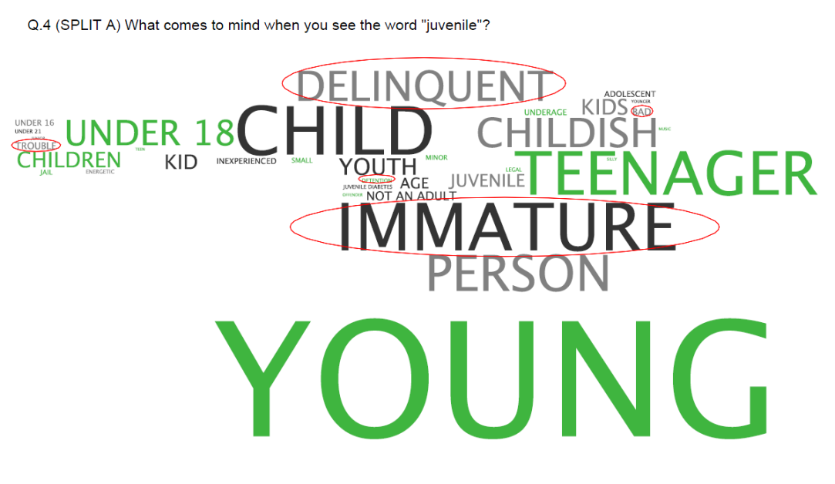
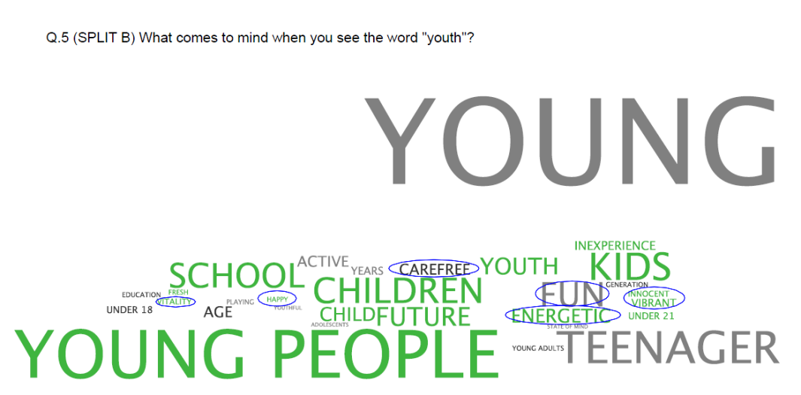
“Juvenile” Elicits Negative Reactions; “Youth” Much More Positive
Juvenile
Youth
Q4. (SPLIT A) What comes to mind when you see the word “juvenile”?
Q4. (SPLIT B) What comes to mind when you see the word “youth”?

Slide 19
Contact Information
Mike Bocian
www.gbastrategies.com
mbocian@gbastrategies.com

